Slide 1



Analysis of Algorithms
Presentation for use with the textbook Data Structures and Algorithms in Java, 6th edition, by M. T. Goodrich, R. Tamassia, and M. H. Goldwasser, Wiley, 2014
Input
Algorithm
Output

Slide 2
Data Structures and Algorithms
A data structure is a systematic way of organizing and accessing data
An algorithm is a step-by-step procedure for performing some task in a finite amount of time

Slide 3
Algorithm
What makes a good algorithm?
Running time
Amount of memory needed

Slide 4
Experimental Studies
4.1

Slide 5
Running Time 1
Most algorithms transform input objects into output objects.
The running time of an algorithm typically grows with the input size.

Slide 6
Running Time 2
Average case time is often difficult to determine.
We focus on the worst case running time.
Easier to analyze
Crucial to applications such as games, finance and robotics

Slide 7
Experimental Studies 1
Write a program implementing the algorithm
Run the program with inputs of varying size and composition, noting the time needed:
Plot the results

Slide 8
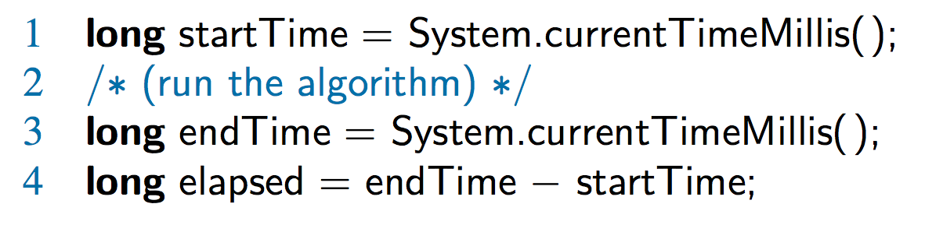
Experimental Studies 2
Record the starting time in milliseconds
Run the algorithm
Record the ending time in milliseconds
Subtract the starting time from the ending time to get the elapsed time

Slide 9
String Experiment

Slide 10
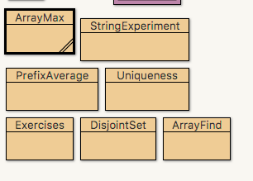
String Experiment Example
Open up DSAJ-sourcecode with BlueJ
find package dsaj.asymptotics
open
file StringExperiment.java

Slide 11
String Experiment on log-log Chart

Slide 12

Limitations of Experiments
It is necessary to implement the algorithm, which may be difficult
Results may not be indicative of the running time on other inputs not included in the experiment.
In order to compare two algorithms, the same hardware and software environments must be used

Slide 13
Moving Beyond Experimental Analysis
4.1.1

Slide 14
Theoretical Analysis
Uses a high-level description of the algorithm instead of an implementation
Characterizes running time as a function of the input size, n
Takes into account all possible inputs
Allows us to evaluate the speed of an algorithm independent of the hardware/software environment

Slide 15
The Random Access Machine (RAM) Model
A RAM consists of
A CPU
An potentially unbounded bank of memory cells, each of which can hold an arbitrary number or character
Memory cells are numbered and accessing any cell in memory takes unit time
2
1
0

Slide 16
Primitive Operations
Basic computations performed by an algorithm
Identifiable in pseudocode
Largely independent from the programming language
Exact definition not important (we will see why later)
Assumed to take a constant amount of time in the RAM model
Examples:
Evaluating an expression
Assigning a value to a variable
Indexing into an array
Calling a method
Returning from a method

Slide 17
Count Primitive Operations
The method of theoretical analysis is to account for primitive actions
Assigning a value to a variable
Following an object reference
Performing an arithmetic operation (for example, adding two numbers)
Comparing two numbers
Accessing a single element of an array by index
Calling a method
Returning from a method

Slide 18
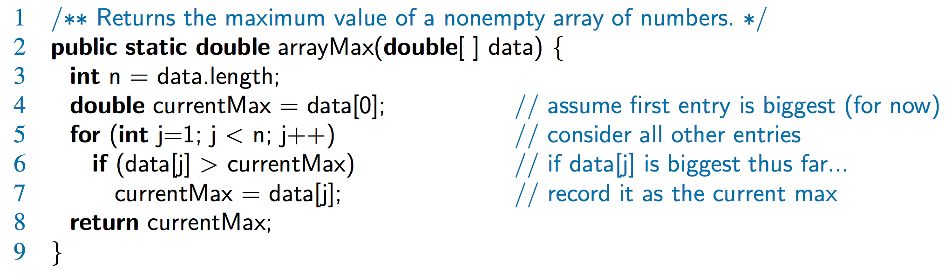
Counting Primitive Operations
By inspecting the pseudocode, we can determine the maximum number of primitive operations executed by an algorithm, as a function of the input size
Step 3: 2 ops, 4: 2 ops, 5: 2n ops, 6: 2n ops, 7: 0 to n ops, 8: 1 op

Slide 19
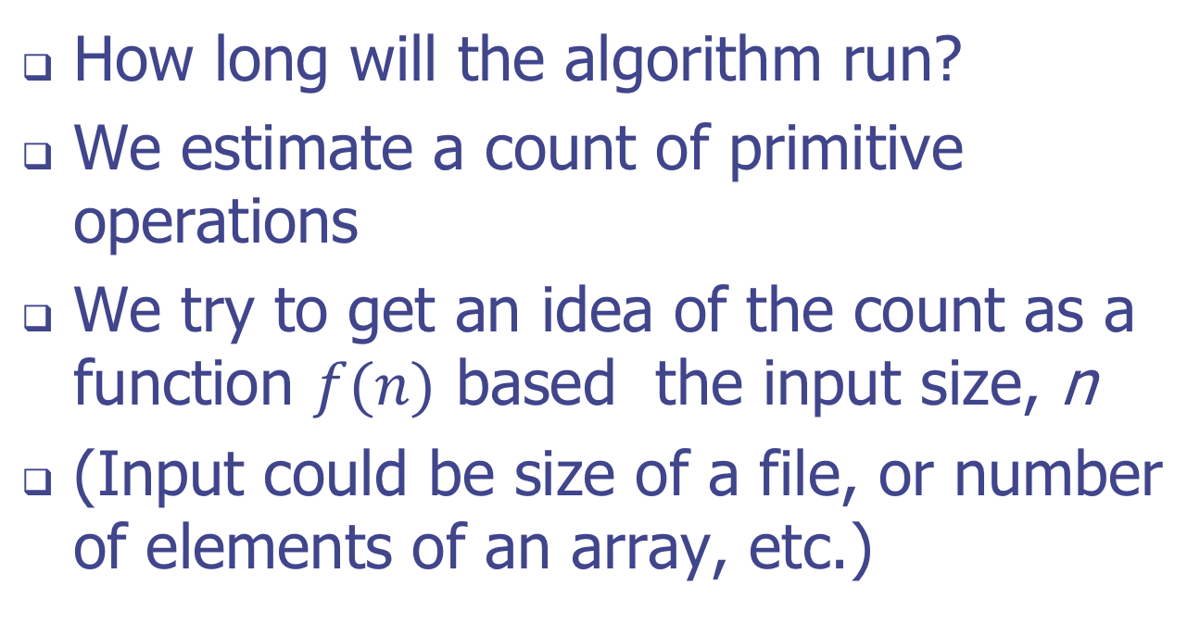
Measuring Operations as a Function of Input Size
How long will the algorithm run?
We estimate a count of primitive operations
We try to get an idea of the count as a function $f(n)$ based the input size, n
(Input could be size of a file, or number of elements of an array, etc.)

Slide 20
Best case, worst case, average case

Slide 21
Worst-case Input
Getting the average case can be hard
Your data may be, at random, all easy cases
The worst cases may be many magnitudes of time longer, will dominate average
Focus on the worst-case scenario

